Slide 1

课时练习
模块五 第三章 第二节

Slide 2
一、翻译下列词组。
1. 对……有信心 ____________________________
2. 处于不好的情绪 __________________________
3. 为……感到骄傲、自豪 ____________________
4. 给某人一个惊喜 __________________________
be confident about …
in a bad mood
be proud of …
give sb. a surprise

Slide 3
一、翻译下列词组。
5. 互相帮助 _____________________________
6. 表演一部短剧 _________________________
7. 在英语角 _____________________________
8. 为……做好准备 _______________________
help each other
put on a short play
at the English Corner
get ready for …

Slide 4
二、根据语境、音标或所给单词的提示完成句子， 每空一词。
1. My mother is a nurse and she takes care of ______ people in a hospital.
2. Chinese players performed so well at the Tokyo Olympics, and we Chinese are _______ /praʊd/ of them.
sick
proud

Slide 5
二、根据语境、音标或所给单词的提示完成句子， 每空一词。
3. The water was a little cold, but I took a bath ________ /'enɪweɪ/.
4. Your _________ is something that you need to show when you enter(进入) or leave a country.
5. Both of the _______ (boss) are so kind, for they often send money to the children in poor areas.
anyway
passport
bosses

Slide 6
三、单项选择。
( )1. I didn’t tell my mother I would have a party for her birthday because I wanted to give her _______.
A. a hand B. a surprise C. a gift
B

Slide 7
三、单项选择。
( )2. —Tina, what are you doing?
—I’m reading an article. It says that staying up late too often may _______ people’s IQ.
A. cause B. protect C. affect
C

Slide 8
三、单项选择。
( )3. —It’ll be fine this Sunday. _______ going for a picnic?
—Good idea!
A. Why not B. What about C. Shall we
B

Slide 9
三、单项选择。
( )4. The boy is afraid _______ cross the bridge, because he is afraid _______ falling into the river.
A. to; to B. of; to C. to; of
C

Slide 10
三、单项选择。
( )5. —The School Art Festival is coming. What are you going to do?
—Oh, we’re going to _______ a painting show in the school hall.
A. put on B. put out C. put up
A

Slide 11
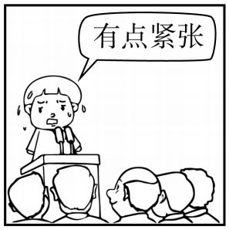
四、看图写话。
1. always, get, when
The boy/He always gets nervous when he gives/makes a speech.

Slide 12
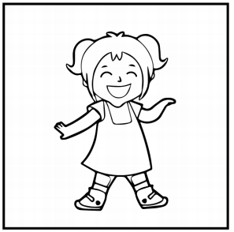
四、看图写话。
2. in, mood
The girl/She is in a good mood.

Slide 13
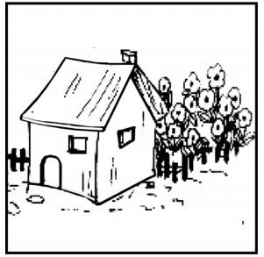
四、看图写话。
3. there be, behind
There are many flowers behind the house.

Slide 14

四、看图写话。
4. want, buy
The girl wants to buy a book for her sister’s birthday./She wants to buy her sister a book.

Slide 15
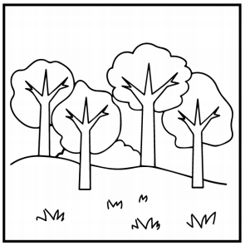
四、看图写话。
5. green, spring
The trees turn green in spring.

Slide 16


